Slide 1

EMPLOYEE LAYOFF PREDICTION
Presented by: Under the Supervision of:
Dr. BAJRANG BANSAL
PRAGY UPADHYAY
Department of ECE
Jaypee Institute of Information Technology, Noida, U.P., India

Slide 2
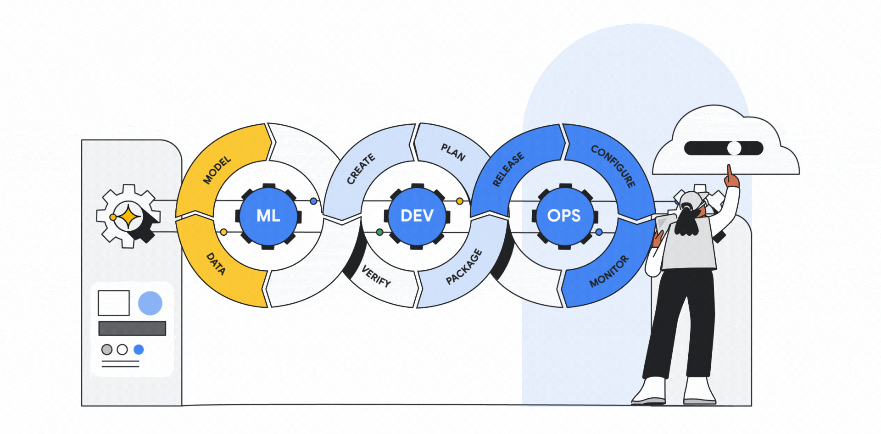
Introduction
Knowledge Economy: Data analysis and information technologies are transforming industries, creating valuable insights and knowledge.[1]
Technological Benefits: Adoption of technology improves efficiency, decision-making, and competitive advantage.
Strategic Asset: Data is now a critical asset for organizations, aiding in business processes across sectors.
AI in Decision-Making: AI is increasingly used in decision-making across various organizational areas, including human resources (HR).[2,3]

Slide 3
Scope of the Project
GLOBAL:
Dataset Characteristics: The IBM employee attrition dataset used in the project represents corporate environments found globally, making it suitable for organizations across various countries.
Universality of the Problem: Employee attrition is a global issue affecting businesses worldwide, with common factors like job satisfaction, compensation, and work-life balance applicable in many regions.
Machine Learning Generalization: The machine learning model developed in this project can be adapted and applied to different global organizations, allowing for broad implementation.

Slide 4
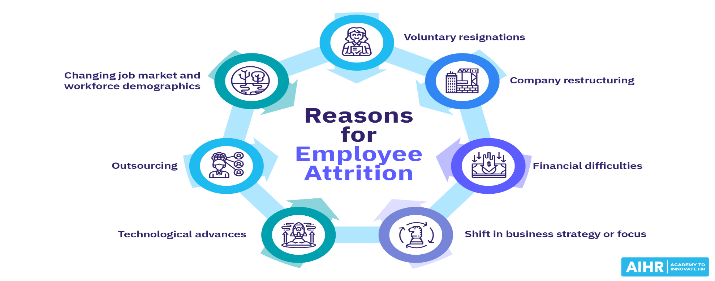
Problem Statement
Increased Focus on HR
Cost of Employee Turnover
Challenge of Retention
Artificial Intelligence in HR
Figure 1 - Reasons for Employee Attrition [6]

Slide 5


Increased Focus on HR
The quality and skill of workers are now seen as essential growth factors, providing a competitive edge to organizations. This elevates HR to a strategic level in business management.
HR departments are leveraging AI and data analytics to assess employee performance, engagement, and well-being. This helps in proactive decision-making, improving employee satisfaction and organizational health.

Slide 6
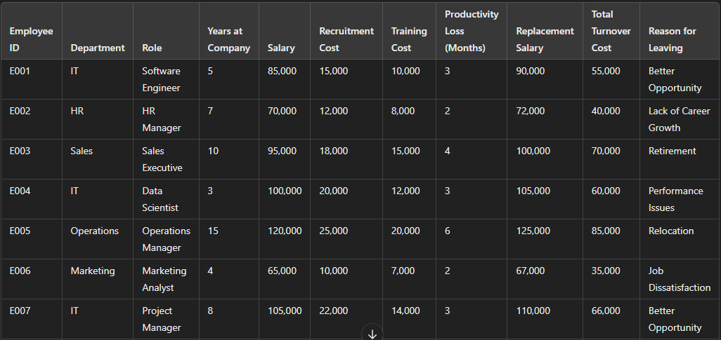
Cost of Employee Turnover
Replacing an employee is significantly more expensive than retaining existing staff, considering recruitment, training, and the time required for new employees to reach full productivity.
Table 1 - Factors showing company cost for an Employee

Slide 7


Challenge of Retention
Keeping permanent employees is a major challenge in today's competitive market, and losing long-term employees affects employer-employee relationships.
Organizational growth is heavily dependent on retaining skilled employees. Frequent turnover negatively impacts morale and organizational stability.

Slide 8

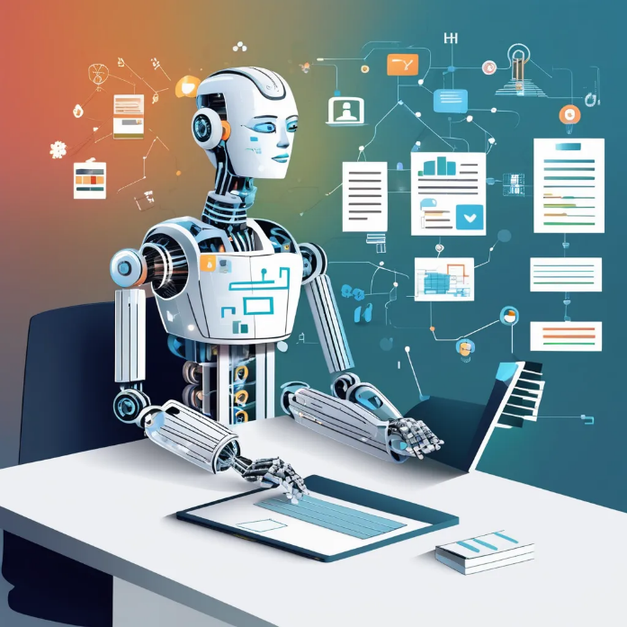
Artificial Intelligence in HR
Artificial intelligence, which has proven valuable in sales and marketing, is now becoming important in employee-related HR decisions
AI’s ability to analyze employee behavior, performance, and satisfaction can help predict and reduce employee attrition. This adds a proactive layer to HR’s role in ensuring workforce stability.

Slide 9
Literature Survey
Title | Author | Publishing Year
Predicting Employee Attrition Using Machine Learning Techniques | F. Fallucchi, M. Coladangelo, R. Giuliano, and E. W. De Luca | 2020
Analyzing Employee Attrition Using Machine Learning | Usha P. M. and N. V. Balaji | 2019
Explaining and Predicting Employee’s Attrition | P. K. Jain, M. Jain, and R. Pamula | 2020
Machine Learning Approach for Employee Attrition Analysis | Dr. R. S. Kamath, Dr. S. S. Jamsandekar, Dr. P. G. Naik | 2019
Predicting Employee Attrition using Machine Learning Approaches | A. Raza, K. Munir, M. Almutairi, F. Younas, and M. M. S. Fareed | 2022

Slide 10
Literature Survey
Title | Author | Publishing Year
Employee Attrition Prediction using Machine Learning | P. N. Gandhi, A. Jangale, G. S. Mhaske, and A. Kadlag | 2020
Machine Learning for Predicting Employee Attrition | N. Mansor, N. S. Sani, and M. Aliff | 2021
Employee Attrition Prediction Using Machine Learning Models | H. Alqahtani, H. Almagrabi, and A. Alharbi | 2024
Employee Attrition Prediction Using Stacking and Its Evaluation | Rema, Ruchitha V., Mythri K., and Hariprasad V | 2021
Prediction of Employee Attrition Using Machine Learning | S. Kaushik, R. Anusha, B. Kavitha, and N. Krishna Priya | 2020

Slide 11
Predicting Employee Attrition Using Machine Learning Techniques
AUTHOR: F. Fallucchi, M. Coladangelo, R. Giuliano, and E. W. De Luca
PUBLISHING YEAR: 2020
KEY CONCEPTS:
Various machine learning models (Gaussian Naive Bayes, Logistic Regression, Decision Trees, SVM) were applied.
A real-world IBM dataset with 35 features from 1,500 employees was used to train and test the models.
Gaussian Naive Bayes provided the best performance, evaluated using accuracy, recall, precision, and F1-score.[4]
F. Fallucchi, M. Coladangelo, R. Giuliano, and E. W. De Luca, "Predicting Employee Attrition Using Machine Learning Techniques," *Computers*, vol. 9, no. 4, p. 86, 2020. [Online]. Available: https://doi.org/10.3390/computers9040086

Slide 12
Analyzing Employee Attrition Using Machine Learning
AUTHOR: Usha P. M. and N. V. Balaji
PUBLISHING YEAR: 2019
KEY CONCEPTS:
Machine learning is used to analyze employee attrition and mitigate its impact on business competitiveness.
J48, Naive Bayes, K-Means, and EM algorithms were tested.
J48 algorithm achieved the highest accuracy (82.45% with cross-validation).[5]
Usha P. M. and N. V. Balaji, "Analyzing Employee Attrition Using Machine Learning," Karpagam Journal of Computer Science, vol. 13, pp. 277-282, Sep.-Oct. 2019.

Slide 13
Explaining and Predicting Employee’s Attrition
AUTHOR: P. K. Jain, M. Jain, and R. Pamula
PUBLISHING YEAR: 2020
KEY CONCEPTS:
Models used: Support Vector Machine (SVM), Decision Tree (DT), and Random Forest (RF), with RF achieving the best accuracy (99%).
Key findings: High attrition rates among employees with low satisfaction, low/medium salaries, and those in technical, sales, and support roles.
RF showed superior precision, recall, and F1-scores, especially in departments like Sales, IT, and Support.[6]
P. K. Jain, M. Jain, and R. Pamula, "Explaining and predicting employees’ attrition: a machine learning approach," SN Applied Sciences, vol. 2, no. 757, pp. 1-12, Mar. 2020, doi: 10.1007/s42452-020-2519-4.

Slide 14
Machine Learning Approach for Employee Attrition Analysis
AUTHOR: Dr. R. S. Kamath, Dr. S. S. Jamsandekar, Dr. P. G. Naik
PUBLISHING YEAR: 2019
KEY CONCEPTS:
The study addresses talent management by predicting employee attrition, impacting organizational productivity.
Models explored: Decision Trees, Random Forest, SVM, and Linear Regression, with Random Forest performing best.
Performance was evaluated using Error Matrix and Pseudo R-Square, with Random Forest achieving the highest accuracy.[7]
R. S. Kamath, S. S. Jamsandekar, and P. G. Naik, "Machine Learning Approach for Employee Attrition Analysis," International Journal of Trend in Scientific Research and Development (IJTSRD), Conference Issue, pp. 62-67, March 2019. Available: https://www.ijtsrd.com/papers/ijtsrd23065.pdf.

Slide 15
Predicting Employee Attrition using Machine Learning Approaches
AUTHOR: A. Raza, K. Munir, M. Almutairi, F. Younas, and M. M. S. Fareed
PUBLISHING YEAR: 2022
KEY CONCEPTS:
The study uses machine learning to predict employee attrition, identifying factors like income, age, and tenure as key predictors using the IBM HR Employee Attrition dataset.
The Extra Trees Classifier achieved the highest accuracy (93%), providing a robust tool for HR practitioners to design targeted retention strategies.
The research highlights that younger employees with lower income and shorter tenure are at the highest risk of attrition, offering actionable insights for proactive retention efforts.[8]
A. Raza, K. Munir, M. Almutairi, F. Younas, and M. M. S. Fareed, "Predicting employee attrition using machine learning approaches," *Applied Sciences*, vol. 12, no. 13, p. 6424, Jun. 2022. doi: [10.3390/app12136424]

Slide 16
Employee Attrition Prediction using Machine Learning
AUTHOR: P. N. Gandhi, A. Jangale, G. S. Mhaske, and A. Kadlag
PUBLISHING YEAR: 2020
KEY CONCEPTS:
The study utilizes machine learning, with data from the IBM HR Analytics dataset, to predict employee attrition by identifying key factors like income, overtime, and tenure as significant predictors.
The Random Forest algorithm outperformed others, achieving the highest accuracy, providing a reliable tool for predicting attrition and supporting targeted retention strategies.
The research highlights the effectiveness of feature selection and SMOTE in improving model performance and ensuring balanced predictions for actionable HR insights.[9]
P. N. Gandhi, A. Jangale, G. S. Mhaske, and A. Kadlag, "Employee attrition prediction using machine learning,“ *Journal of Emerging Technologies and Innovative Research (JETIR)*, vol. 7, no. 9, pp. 1086–1094, Sep. 2020

Slide 17
Machine Learning for Predicting Employee Attrition
AUTHOR: N. Mansor, N. S. Sani, and M. Aliff
PUBLISHING YEAR: 2021
KEY CONCEPTS:
The study evaluates three machine learning models—Decision Tree, SVM, and ANN—using the IBM HR dataset to predict employee attrition, identifying factors like overtime, income, and manager tenure as key predictors.
SVM emerged as the most effective model, achieving 87.76% test accuracy due to its robustness with high-dimensional and imbalanced data, outperforming Decision Tree and ANN.[10]
N. Mansor, N. S. Sani, and M. Aliff, "Machine Learning for Predicting Employee Attrition," *International Journal of Advanced Computer Science and Applications (IJACSA)*, vol. 12, no. 11, pp. 435–445, 2021.

Slide 18
Employee Attrition Prediction Using Machine Learning Models
AUTHOR: H. Alqahtani, H. Almagrabi, and A. Alharbi
PUBLISHING YEAR: 2024
KEY CONCEPTS:
The review highlights the effectiveness of ML models like Random Forest, XGBoost, and deep learning techniques for predicting employee attrition, emphasizing their ability to handle imbalanced datasets.
Feature selection methods such as RFE and Chi-square tests identify key predictors like income, experience, and job satisfaction.
Ensemble learning methods, including AdaBoost and Gradient Boosting, outperform single models, offering robust and accurate predictions for real-world HR applications.[11]
H. Alqahtani, H. Almagrabi, and A. Alharbi, "Employee Attrition Prediction Using Machine Learning Models: A Review Paper," *International Journal of Artificial Intelligence and Applications (IJAIA)*, vol. 15, no. 2, pp. 1–25, Mar. 2024. DOI: 10.5121/ijaia.2024.1520223.

Slide 19
Employee Attrition Prediction Using Stacking and Its Evaluation
AUTHOR: Rema, Ruchitha V., Mythri K., and Hariprasad V
PUBLISHING YEAR: 2021
KEY CONCEPTS:
The study uses machine learning and ensemble stacking with Decision Tree as the meta-learner, achieving 98% accuracy in predicting employee attrition.
Key predictors of attrition include job satisfaction, evaluation scores, and workload extremes, with mid-level employees (4–5 years tenure) showing higher turnover risks.
The research emphasizes proactive HR strategies informed by predictive insights to address employee concerns and reduce turnover.[12]
Rema, Ruchitha V., Mythri K., and Hariprasad V., "Employee Attrition Prediction Using Stacking and Its Evaluation," *International Research Journal of Engineering and Technology (IRJET)*, vol. 8, no. 8, pp. 764–771, Aug. 2021

Slide 20
Prediction of Employee Attrition Using Machine Learning
AUTHOR: S. Kaushik, R. Anusha, B. Kavitha, and N. Krishna Priya
PUBLISHING YEAR: 2020
KEY CONCEPTS:
The study uses machine learning algorithms (Random Forest and SVM) to predict employee attrition, with Random Forest achieving 77% accuracy.
Key attrition predictors include job dissatisfaction, low salaries, limited promotions, and high workload, emphasizing the need for targeted retention strategies.
The research stresses the importance of addressing underlying factors like work environment and career growth opportunities to reduce attrition and improve organizational stability.[13]
S. Kaushik, R. Anusha, B. Kavitha, and N. Krishna Priya, "Prediction of Employee Attrition Using Machine Learning," Journal of Engineering Sciences, vol. 11, no. 4, pp. 25-31, Apr. 2020.

Slide 21



Research Gap
Focus on Employee-Specific Factors
Advanced Machine Learning Techniques
Impact of Remote Work and Flexible Policies
Random Forest
SVM
Decision Trees
Ada Boost

Slide 22
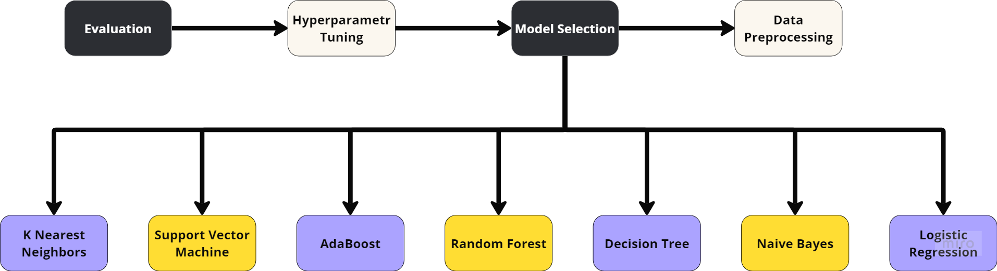
Methodology
Figure 2 - Flowchart showcasing Project Methodology

Slide 23
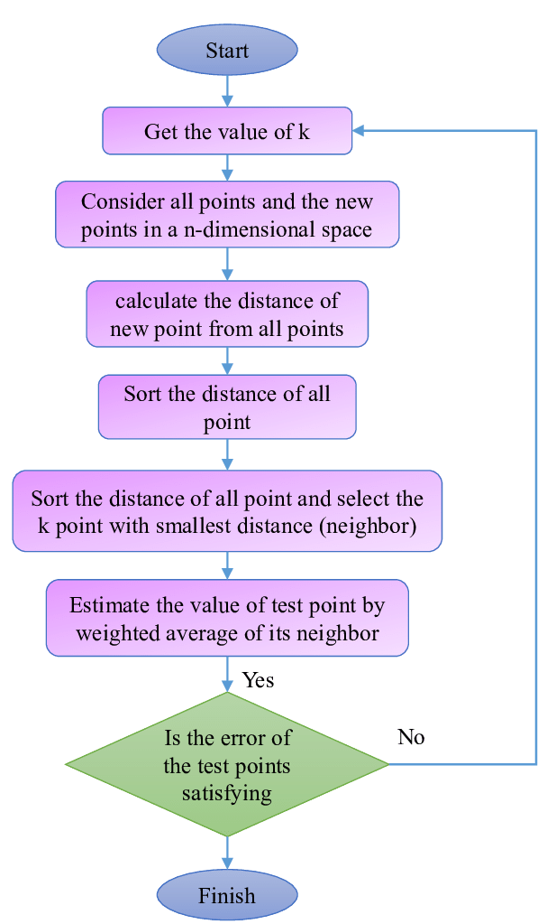
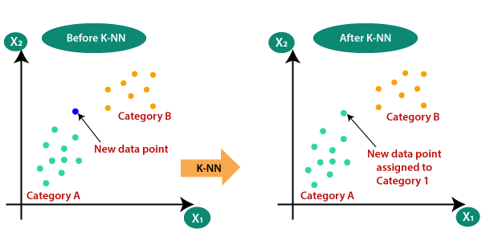

Implementation
K-Nearest Neighbor (KNN)
Support Vector Machine (SVM)
Figure 3 - Graphical Representation of KNN
Figure 5 - Graphical Representation of SVM Figure 4 - Flowchart Showing KNN Working

Slide 24
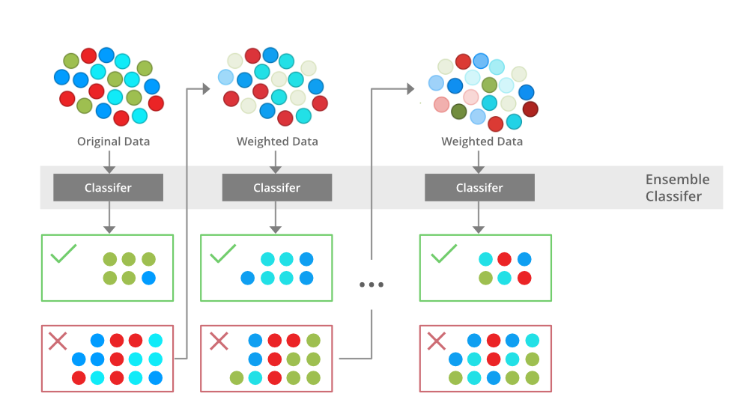

AdaBoost Algorithm
Decision Tree classification Algorithm
Figure 6 – Diagram Showing Implementation of ADABOOST Algorithm
Figure 7 – Diagram Showing Implementation of Decision Tree

Slide 25
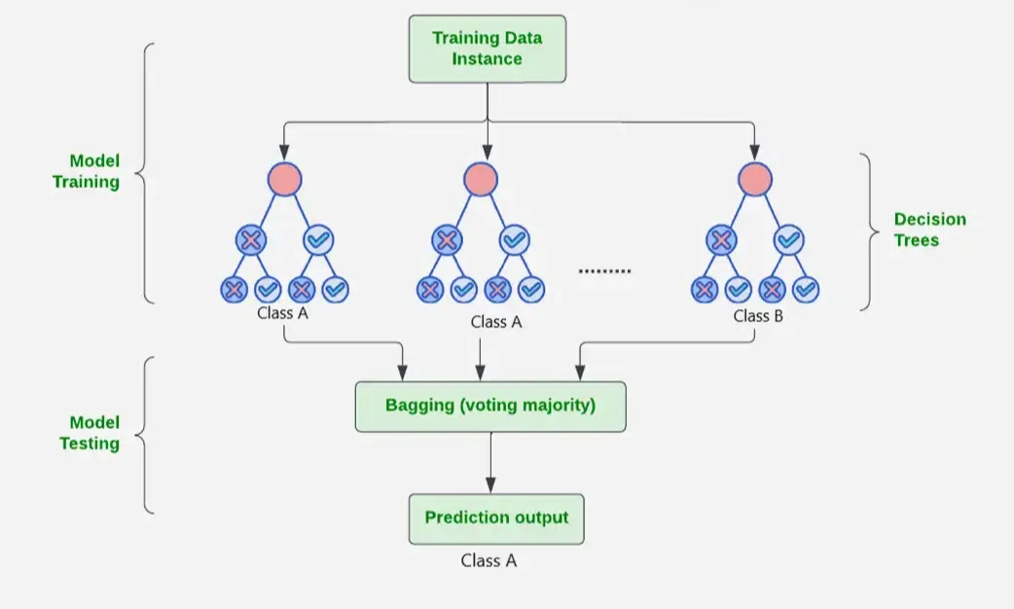
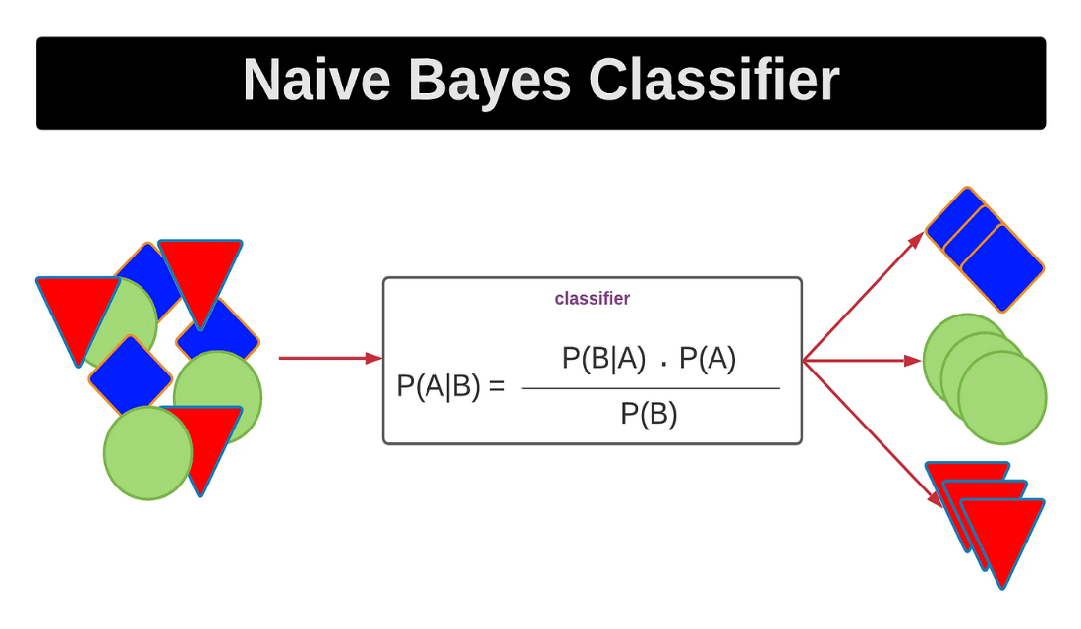
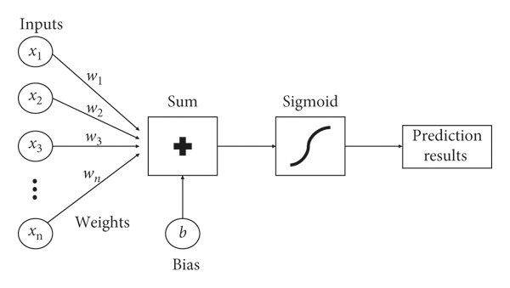
Random Forest Algorithm
Naïve Bayes Classifier Algorithm Logistic Regression
Figure 8 – Flowchart Showing Implementation of Random Forest Algorithm
Figure 9 – Diagram Showing Implementation of Naïve Bayes Algorithm Figure 10 – Working of Logistic Regression

Slide 26
Results & Discussion (Mid Term)
The Best performance was obtained in Random Forest Model with Under sampling with an accuracy of 74.6%, the precision of 74.5%, recall of 75.1% and F1 Score of 74.7% shown in Table 2.
Model | Accuracy | Precision | Recall | F1
Logistic Regression | 0.734 | 0.739 | 0.734 | 0.734
Naïve Bayes | 0.653 | 0.624 | 0.776 | 0.691
Decision Trees | 0.639 | 0.650 | 0.615 | 0.629
Random Forest | 0.746 | 0.745 | 0.751 | 0.747
AdaBoost | 0.736 | 0.739 | 0.734 | 0.735
SVM | 0.729 | 0.734 | 0.730 | 0.729
KNN | 0.736 | 0.792 | 0.641 | 0.707
Table 4: Oversampled Data with PCA
Table 4 - Showcasing Results Of Different Machine Learning Models
Table 2 – Undersampling Data Results

Slide 27
Results & Discussion
The Best performance was obtained in Random Forest Model with Oversampling with an accuracy of 99.1%, the precision of 98.5%, recall of 99.7% and F1 Score of 99.1% shown in Table 3.
Model | Accuracy | Precision | Recall | F1
Logistic Regression | 0.753 | 0.755 | 0.751 | 0.752
Naïve Bayes | 0.680 | 0.649 | 0.782 | 0.709
Decision Trees | 0.872 | 0.826 | 0.944 | 0.880
Random Forest | 0.991 | 0.985 | 0.997 | 0.991
AdaBoost | 0.987 | 0.977 | 0.997 | 0.987
SVM | 0.604 | 0.590 | 0.680 | 0.632
KNN | 0.824 | 0.741 | 0.997 | 0.850
Table 3 – Oversampling Data Results

Slide 28
Results & Discussion
The Best performance was obtained in Random Forest Model with PCA and Oversampling with an accuracy of 99.2%, the precision of 98.6%, recall of 99.8% and F1 Score of 99.2% shown Table 4.
Model | Accuracy | Precision | Recall | F1
Logistic Regression | 0.758 | 0.751 | 0.771 | 0.761
Naïve Bayes | 0.680 | 0.649 | 0.782 | 0.709
Decision Trees | 0.841 | 0.796 | 0.917 | 0.852
Random Forest | 0.992 | 0.986 | 0.998 | 0.992
AdaBoost | 0.989 | 0.982 | 0.998 | 0.990
SVM | 0.951 | 0.912 | 0.998 | 0.953
KNN | 0.894 | 0.826 | 0.998 | 0.904
Table 4 – Oversampling with PCA Results

Slide 29
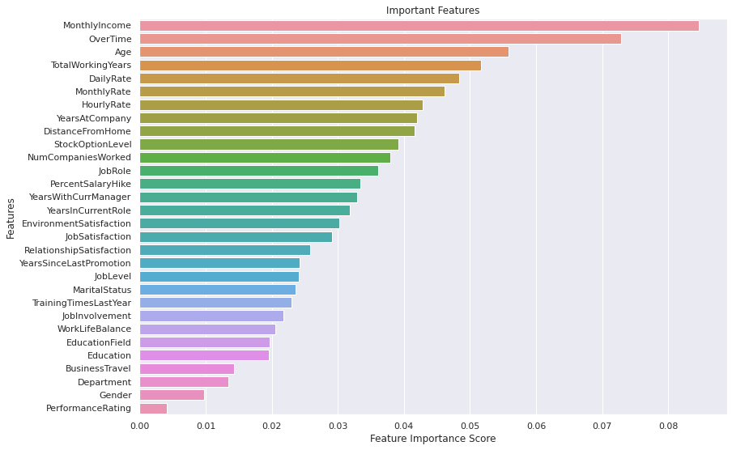
Results & Discussion
We observe that the most important features were MonthlyIncome followed by OverTime and Age, while the least important features were Performance Rating, Gender and BusinessTravel shown in Fig. 11.
Figure 11 – Feature Importance w.r.t Random Forest Oversampling

Slide 30
Conclusion
Best Model Performance:
The Random Forest model with PCA and oversampling achieved the highest metrics:
Accuracy: 99.2%
Precision: 98.6%
Recall: 99.8%
F1 Score: 99.2%.
High-Performing Models:
Tree-based models (Random Forest, Decision Trees, AdaBoost) and SVM consistently delivered top results, with SVM achieving accuracy and F1 scores above 90%.
3. Impact of PCA and Oversampling:
PCA combined with oversampling improved most models' performance, except for Logistic Regression and Naive Bayes.

Slide 31
Conclusion
4. Key Influencing Factors:
Monthly Income, Age, Overtime, and Total Working Years significantly influenced employee attrition, while Gender had no impact.
5. Data-Driven Insights:
Preprocessing techniques like PCA and oversampling are critical for enhancing model performance and ensuring balanced datasets.
6. Comprehensive Model Comparison:
A variety of models, including Logistic Regression, Naive Bayes, KNN, and SVM, were evaluated, showcasing diverse approaches to classification with consistent performance improvements through advanced preprocessing techniques.

Slide 32
References
[1] J. Smith, The Knowledge Economy and Data: Leveraging Information Technology for Strategic Advantage, Journal of Business Data, vol. 12, no. 3, pp. 45-67, 2022.
[2] A. Johnson and M. Patel, Big Data Analytics and Decision-Making: A Path to Corporate Success, Business Analytics Journal, vol. 9, no. 2, pp. 23-42, 2021.
[3] K. Brown, Information Technologies in the Modern Enterprise: A Study of Data's Role in Competitiveness, International Journal of Technology Management, vol. 8, no. 1, pp. 101-120, 2020.
[4] F. Fallucchi, M. Coladangelo, R. Giuliano, and E. W. De Luca, "Predicting Employee Attrition Using Machine Learning Techniques," *Computers*, vol. 9, no. 4, p. 86, 2020. [Online]. Available: https://doi.org/10.3390/computers9040086
[5] Usha P. M. and N. V. Balaji, "Analyzing Employee Attrition Using Machine Learning," Karpagam Journal of Computer Science, vol. 13, pp. 277-282, Sep.-Oct. 2019.
[6] P. K. Jain, M. Jain, and R. Pamula, "Explaining and predicting employees’ attrition: a machine learning approach," SN Applied Sciences, vol. 2, no. 757, pp. 1-12, Mar. 2020, doi: 10.1007/s42452-020-2519-4
[7] R. S. Kamath, S. S. Jamsandekar, and P. G. Naik, "Machine Learning Approach for Employee Attrition Analysis," International Journal of Trend in Scientific Research and Development (IJTSRD), Conference Issue, pp. 62-67, March 2019. Available: https://www.ijtsrd.com/papers/ijtsrd23065.pdf.

Slide 33
References
[8] A. Raza, K. Munir, M. Almutairi, F. Younas, and M. M. S. Fareed, "Predicting employee attrition using machine learning approaches," *Applied Sciences*, vol. 12, no. 13, p.6424, Jun. 2022. doi: [10.3390/app12136424] (https://doi.org/10.3390/app12136424)
[9] P. N. Gandhi, A. Jangale, G. S. Mhaske, and A. Kadlag, "Employee attrition prediction using machine learning," *Journal of Emerging Technologies and Innovative Research (JETIR)*, vol. 7, no. 9, pp. 1086–1094, Sep. 2020. [Online]. Available: https://www.jetir.org
[10] N. Mansor, N. S. Sani, and M. Aliff, "Machine Learning for Predicting Employee Attrition," *International Journal of Advanced Computer Science and Applications (IJACSA)*, vol. 12, no. 11, pp. 435–445, 2021.
[11] H. Alqahtani, H. Almagrabi, and A. Alharbi, "Employee Attrition Prediction Using Machine Learning Models: A Review Paper," *International Journal of Artificial Intelligence and Applications (IJAIA)*, vol. 15, no. 2, pp. 1–25, Mar. 2024. DOI: 10.5121/ijaia.2024.1520223.
[12] Rema, Ruchitha V., Mythri K., and Hariprasad V., "Employee Attrition Prediction Using Stacking and Its Evaluation," *International Research Journal of Engineering and Technology (IRJET)*, vol. 8, no. 8, pp. 764–771, Aug. 2021.
[13] S. Kaushik, R. Anusha, B. Kavitha, and N. Krishna Priya, "Prediction of Employee Attrition Using Machine Learning," Journal of Engineering Sciences, vol. 11, no. 4, pp. 25-31, Apr. 2020.

